Slide 1

Vision To Success Intermediate Petrochemicals Industries (IPI)

Slide 2
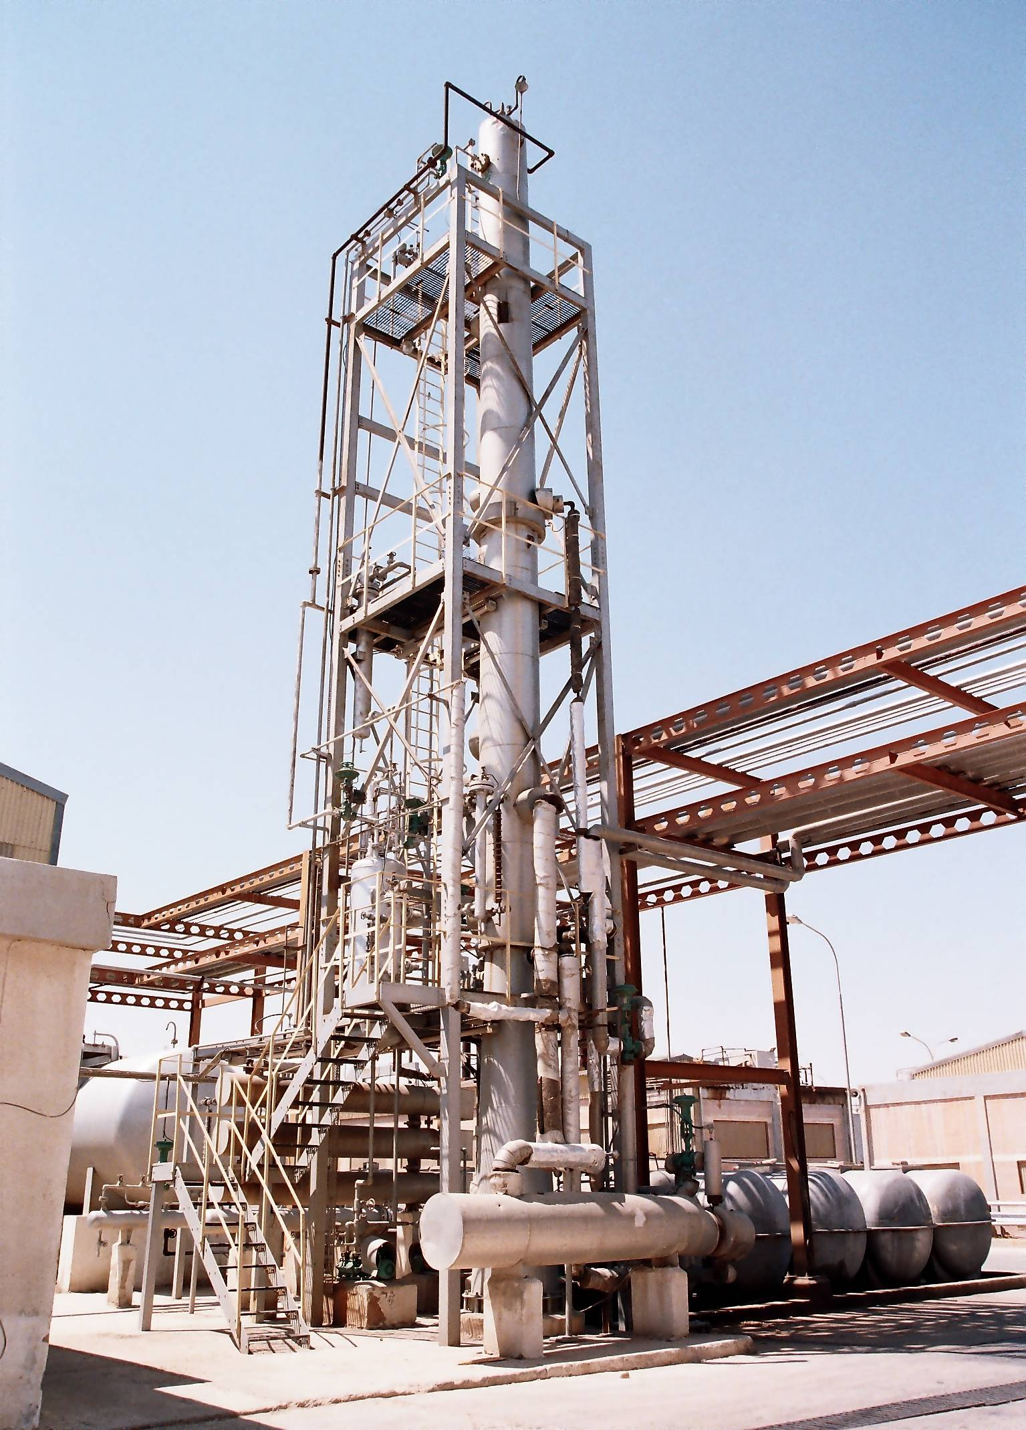
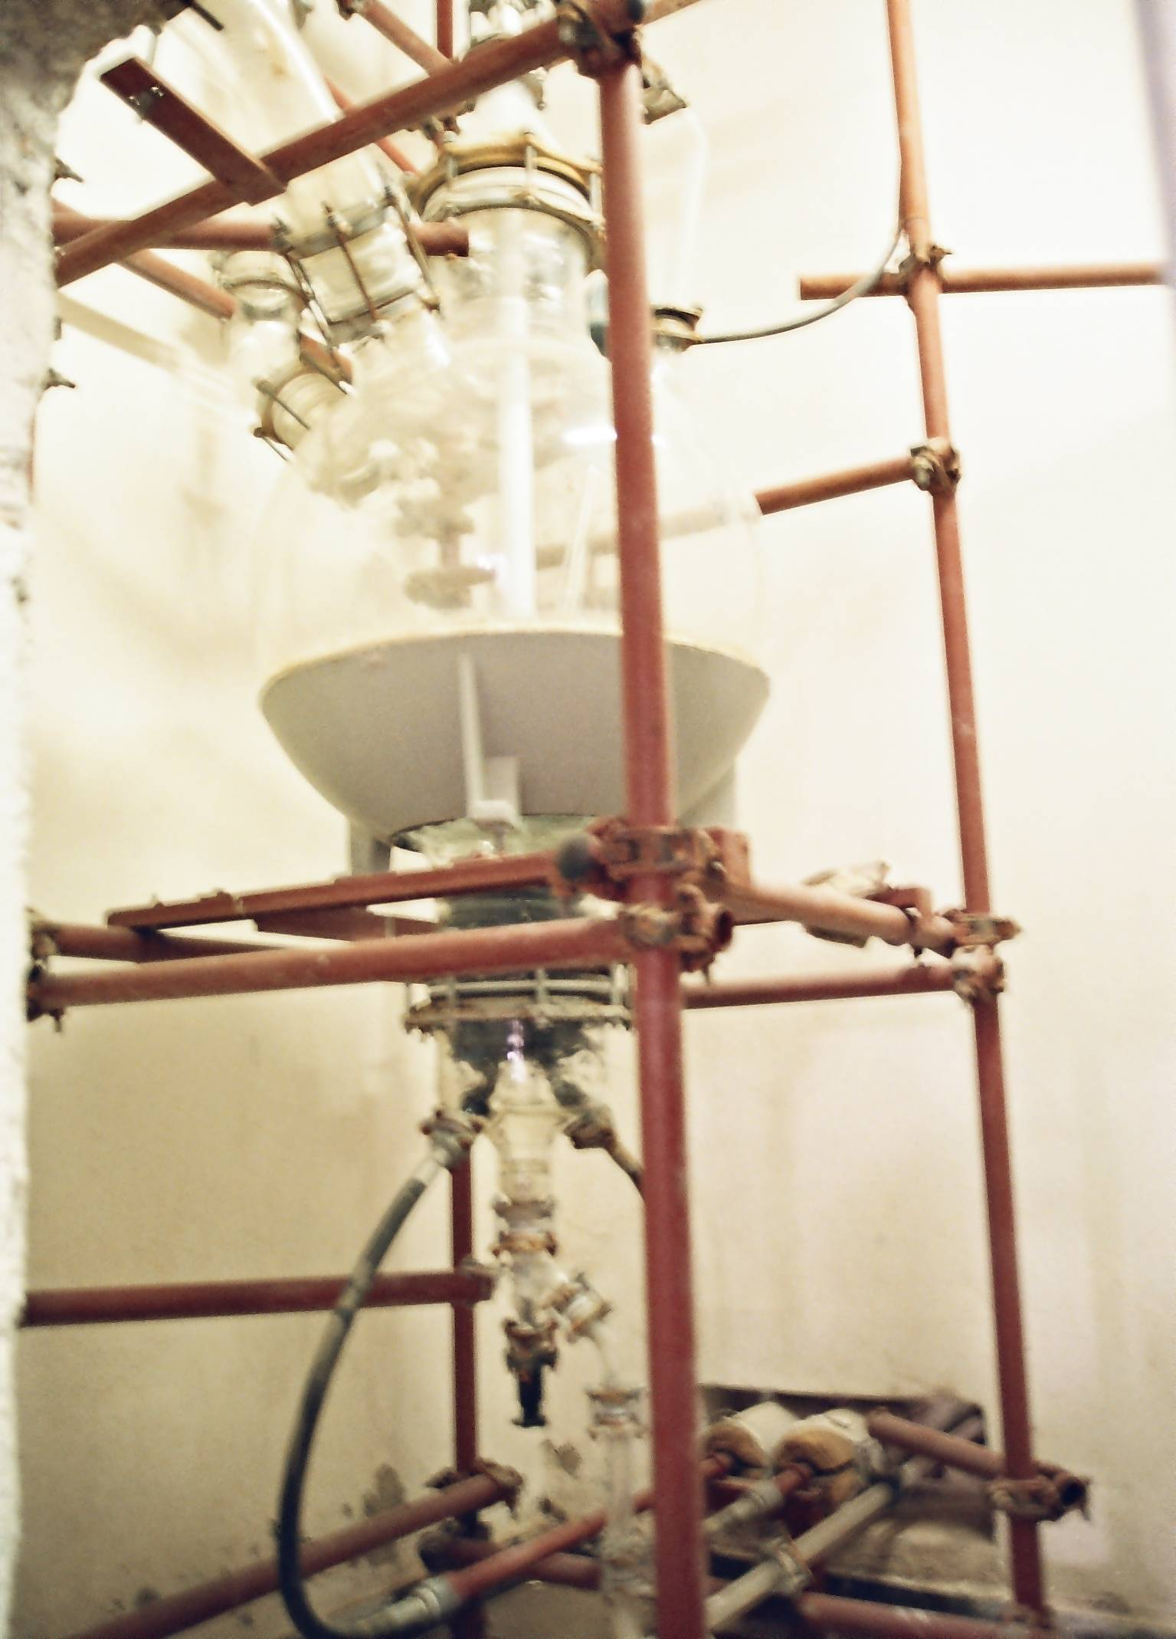
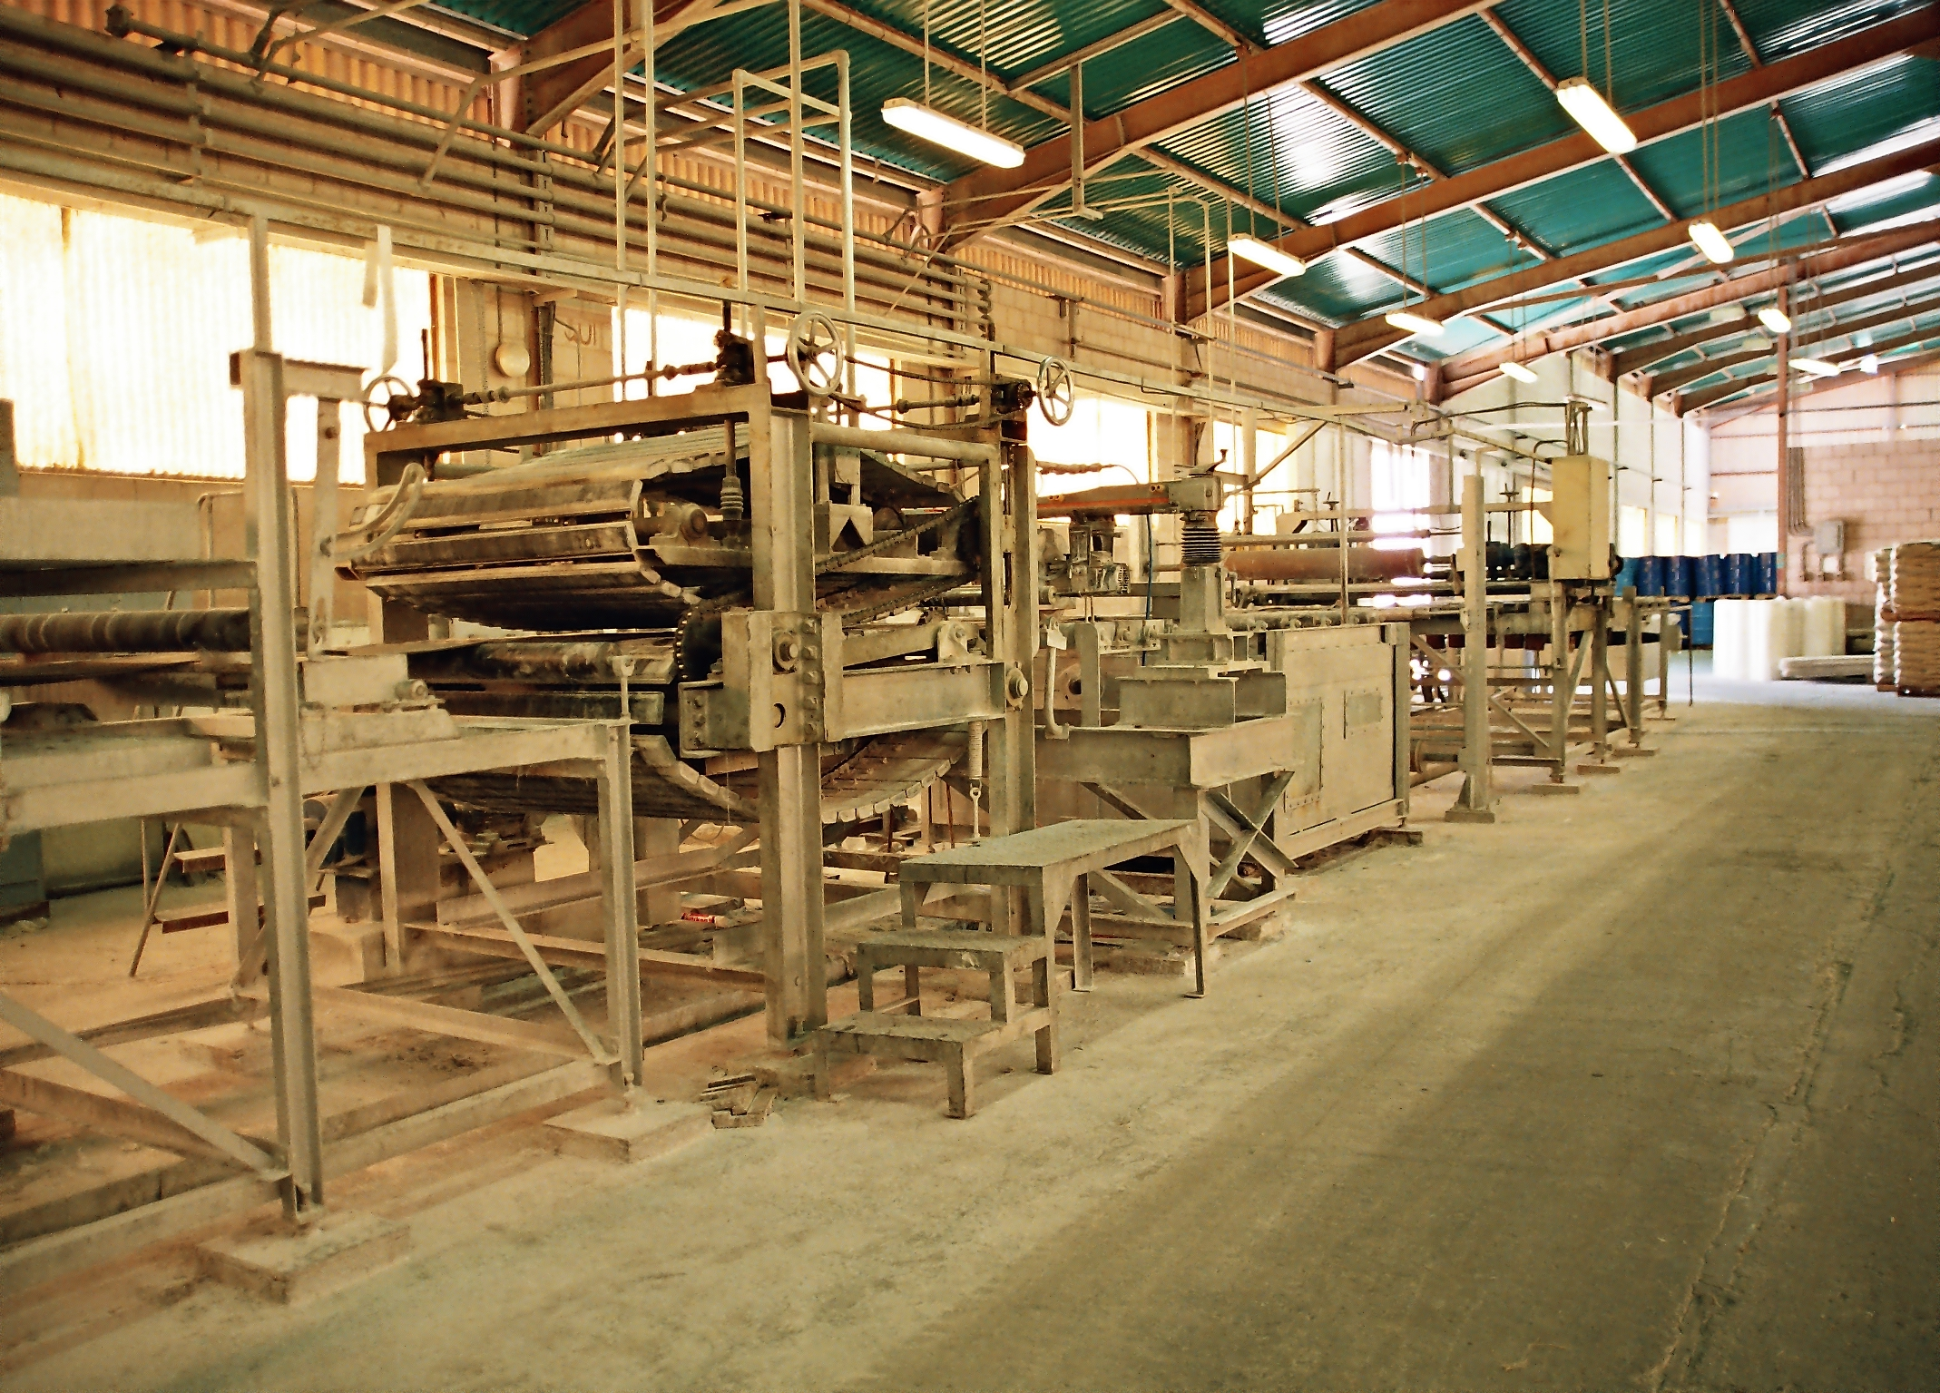
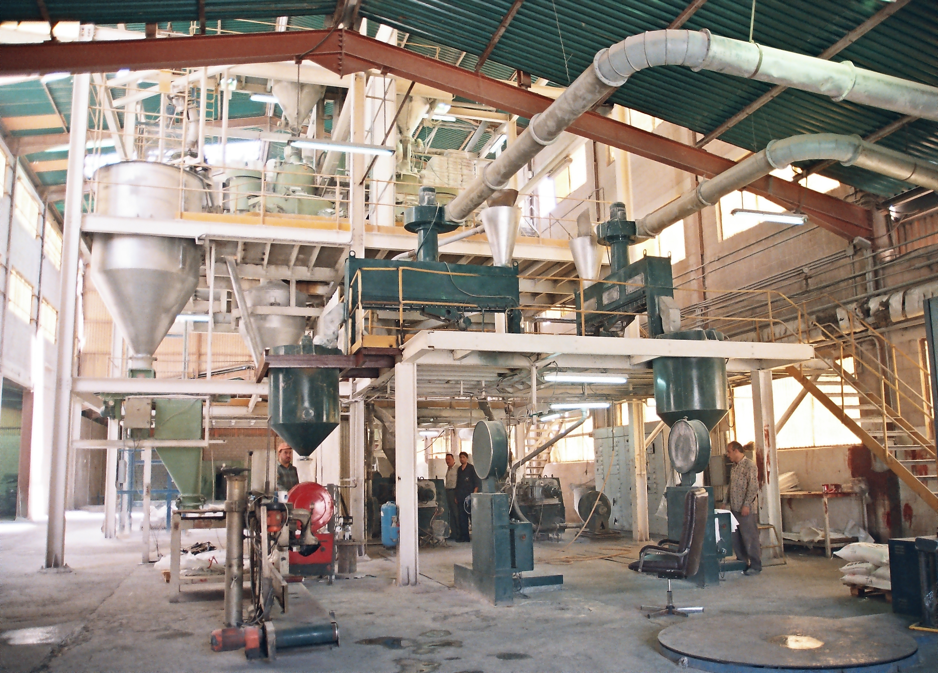
Who is IPI ??
Intermediate Petrochemicals Industries Co. Ltd. Is a public Share holding company established in 1980.
A unique industrial complex in the field of intermediate petrochemical industries was established with the assistance of several international chemical companies who participated in the know-How support at the company’s start up.
The company started production in 1984 to cover part of the local and surrounding markets needs for the intermediate petrochemicals products and related chemical materials.
The company has eight plants (Industrial units) in addition to utilities units , built on a 67000 square meters land including 11000 square meters of covered steel structures , 5000 square meters of concrete buildings and 4800 cubic meters liquid bulk storage tank facilities.
Our good understanding of the changing markets needs and trends as well as the highly qualified staff have always been the reason to gain and maintain our customers trust.

Slide 3
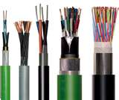
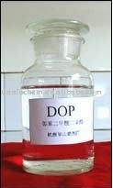
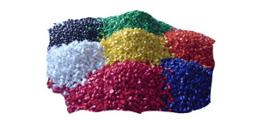


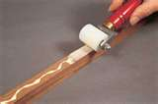
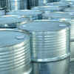
IPI FACTORIES
DOP
PVC
Fiberglass
Sheets
MB
IPI
Urea
Formaldehyde
Polyester
Solvents
Peroxide

Slide 4
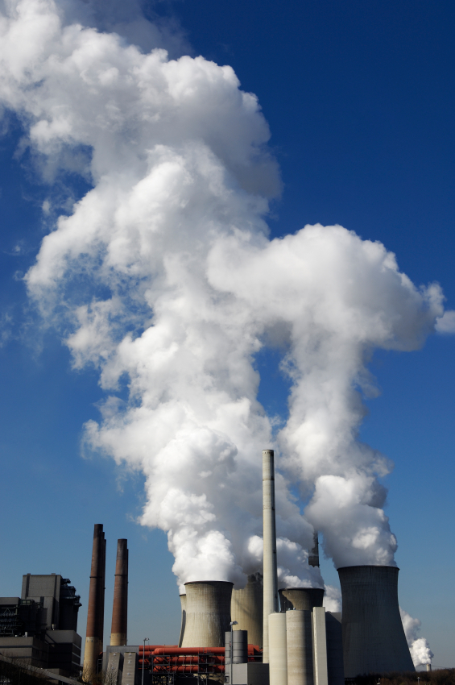

Products & Where to be used:
Factories Products | Industries to be used at:
MONOMERIC PLASTICIZERS | FOR THE PRODUCTION OF FLEXIBLE PVC COMPOUNDS, PAINTS , TANNING AND ADHESIVES, AVAILABLE IN VARIOUS GRADES. (DOP, DBP, DIOP,DOA, DINP, DIDP)
UNSATURATED POLYESTERRESINS ORTHOPHTHALIC, ISO PHTHALIC AND HET ACID | FOR PRODUCTION OF RESINOUS MARBLE, SANTARYWEAR, AND FIBERGLASS REINFORCED ARTICLES AND GEL-COAT ETC.
ORGANIC PEROXIDES | INTIATORS FOR UNSATURATED POLYESTER RESINS CURING AVAILABLE IN VARIOUS GRADES, (MEKP, MIPK-P,SPEICAL PEROXIDES…ETC)
COLOR CONCENTRATES | FOR THE TINTING OF POLYESTER RESINS AND GELCOAT
PVC COMPOUNDS POWER (DRY BLEND) GRANULES PASTE (PLASTESOL) | FOR PRODUCTION OF BOTTLES ,, CABLES, SHOES, IRRIGATION SHEETS, SYNTHETIC LEATHER, WINDOW PROFILES, SGUTTERS, PIPES, ELECTRICAL CONDUITS, CORRUGATED PIPS AND FITTINGS. PLASTISOL (LIQUID PVC COMPOUNDS) USED FOR CROWN LINING, AIR FILTERS, SYNTHETIC LEATHER AND KIDS TOYS.
P.V.C ONE PACK | MASTERBATCH BLENDS (ONE PACK) ADDITIVES FOR PVC CMPOUNDING APLICABLE FOR AWIDE RANGE OF P.V.C COMPOUNDS
P.V.C COLOR MASTERBATCHES | PELLETS OF DIFFERENT COLOURS FOR THE FLEXIBLE P.V.C COMPOUNDS INDUSTRY INCLOUDING CABLES, SHOES, HOSES, SHEETS AND PROFILES
UREA FORMAL DEHYDE AND PHENOLIC RESINS | FOR PRODUCTION OF PLYWOOD, CHIPBOARDS, BLOCKBOARDS, ROCK-WOOL,SHELL SAND AND UREA PRILLS ANTICAKING
LOW AROMATIC SOLVANTS | FOR THE PRODUCTION OF PAINTS, ALKYDS, DRR\IERS AND INSECTICIDES
FIBER GLASS REINFORCED POLYESTER SHEETS | DECORATIVE CALDDING AND ARGICULATURAL GREEN HOUSES, AVAILABLE IN VARIOUS PROFILES AND COLORS
P.O. MASTERBATCH , POLYETHYLENE FILLER AND P.P. COMPOUNDS | FOR THE COLROING OF P.E.,HDPE,P.P. AND P.S., P.E. FILLER AND P.P. COMPOUNDS ARE USED IN P.E FILM, RAFIA BAGS AND GRADEN FURNITURE

Slide 5
What is the Story??
* Period 1: (1985-1992) - Good Start and Sales - Production Capacity used: 30% - Capital is 4M, Profits is 5.7M
* Period 2: (1993-2004) -Shareholders cashed out Profits - No enough money to Buy Raw Materials and depended on Banks - Iraq exports was shut out Production Capacity used: 13% - Losses: 9.9M
* Period 3: (2005-2007) - New Experienced Board - Restructuring the company - Erasing the debts of the Banks - No enough money to buy Raw Materials - Production Capacity used: 8.3% - Losses: 0.5M
* Period 4: (2008-2010) - New Experienced MGMT - New Investor and Capital became 7 Millions - Increasing Capacity due to certain Demands - Improving Facilities from Banks, still not enough - Regaining a major Sales Market Share Locally - Production Capacity used: 12.3%, Profits: 0.65M

Slide 6
What is the Story??
Performance |  | Period 1 (1985-1992) | Period 2 (1993-2004) | Period 3 (2005-2007) | Period 4 (2008-2010) | Target 2011-13
Avg. Sales in Million JD | * Total * Per Year | 47 5.88 | 32 2.66 | 8 2.66 | 15 5.00 | 18-30 6-10
Avg. Sales in Million JD | * Local * Exports | 22.8 →49% 25.0 →51% | 24.1→75% 8.0 →25% | 6.5 →81% 1.5 →19% | 14.3 →95% 0.88 →5% | 50% 50%
Production Rate | * 22,000 MT * 44,300 MT | 30.75% | 13.40% | 8.30% | 12.30% | 13-25%
Total Profits |  | 5.7 →12% | -9.9 →-30% | -0.5 →-6% | 0.65→4% | 3 →10%
Reasons | * Positives * Positives * Positives * Positives * Negatives * Negatives * Negatives | Local Exports | Local Exports (Iraq) Distr. Profits Bad MGMT | New Board Restructuring No Money Quality | New MGMT Investor New Lines Quality Lim. Money Exports | Exports Investor Quality

Slide 7

What is Required? (SUMMARY TO INVESTORS)
It is a fact that there is a big demand on IPI Products as its factories are unique in the region.
It is a fact that the status of the factories are still in very good shape due to the very low production capacity they worked at, in addition to the new 50% of capacity increasing the past 3 years.
It is a fact that any new money injected in the company can bring a significant return in profits
It is a fact that with around 10% of the production capacity IPI can have a breakeven results, which means it is a potential of a very profitable business
It is a fact that the Book Value of these factories are nearly the 1/3 of the real ones these days.
--------------------------------------------------------------------------
What is Needed:
Strong Financing to be able to have enough Raw Materials stock to cover Local clients need, and then move toward exporting
Strong Financing to enable the 8 factories work to their potentials, which will minimize overheads Costs and make IPI very competitive according to the Mass Capacity Policy

Slide 8
Factors Of Success
Raw Materials Costs
Sales Prices
Production
Sales Quantities
Sales Financial Facilities

Slide 9
Raw Materials Costs Invest Low RMC
IPI needs to decrease costs by being able to:
A. choose the right time to buy (If financial ability is available then this might make a big difference)
B. obtain the “Know how” mixing equations when needed
C. dedicate researchers in Purchasing Department to enhance our networking and ability of finding new suppliers

Slide 10
Raw Materials Costs Invest Low RMC
IPI needs to decrease costs by being able to:
A. choose the right time to buy (If financial ability is available then this might make a big difference)
B. obtain the “Know how” mixing equations when needed
C. dedicate researchers in Purchasing Department to enhance our networking and ability of finding new suppliers
The Past 3 Years
Lack of cash made IPI lose big opportunities
Succeeded in not buying RM locally, and in freeing RM in stocks when buying new RMs
Established a Purchasing new computerized system to increase number of suppliers
Succeeded in DOUBLING Bank Loans and facilities
2.0 Millions came from New investor in 2008
Strike CAD & Cash in advance deals to eliminate bank’s charges, obtain better deals, and faster delivery
The Next 3 Years
Continue freeing RMs & no local purchases
Avoid banks & create credits with suppliers
Maintain a healthy Cash Flow
Revolution on Purchasing Department

Slide 11
Actions mean Money
 | Tons | Cost/Ton | Cost | Cost/Ton (99%) | Total Cost (99%) | Savings
Fiberglass | 200 | 2629 | 525,800 | 2603 | 520,542 | 5,258
PVC | 3828 | 1000 | 3,828,000 | 990 | 3,789,720 | 38,280
PEROXIDE | 264 | 2000 | 528,000 | 1980 | 522,720 | 5,280
UREA | 360 | 950 | 342,000 | 941 | 338,580 | 3,420
POLYESTER | 1080 | 1500 | 1,620,000 | 1485 | 1,603,800 | 16,200
FILLER | 8680 | 570 | 4,947,600 | 564 | 4,898,124 | 49,476
MB | 240 | 2100 | 504,000 | 2079 | 498,960 | 5,040
الإجمالي | 14652 |  | 12,295,400 |  | 12,172,446 | 122,954
1% reduction in RM costs means |  |  | 122,954

Slide 12
Sales Prices
IPI can obtain opportunities in increasing their prices by improving their factories to produce new products.
Enter new markets after good marketing and sales plans have been established.
Be able to offer sales financial facilities with good long term returns

Slide 13
Sales Prices
(A) IPI can obtain opportunities in increasing their prices by improving their factories to produce new products.
(B) Enter new markets after good marketing and sales plans have been established.
(C) Be able to offer sales financial facilities with good long term returns
The Past 3 Years
Installed new PVC and Filler & PP Machines to increase capacity and give more flexibility to products
Started exporting to Syria, SA, Palestine, Egypt, and Iraq
Controlled variable and fixed rates to get the correct selling prices (weekly and monthly new prices)
Strike creative financial deals with customers to make sales 90% cash
The Next 3 Years
Continue Controlling variable and fixed rates to get the correct selling prices (weekly and monthly new prices)
Continue working in penetrating all region countries

Slide 14
Actions mean Money
 | Tons | Prices/Ton | Price | Price/Ton (101%) | Prices (101%) | Profits
Fiberglass | 200 | 2829 | 565,800 | 2,857 | 571,458 | 5,658
PVC | 3828 | 1065 | 4,076,820 | 1,076 | 4,117,588 | 40,768
PEROXIDE | 264 | 2272 | 599,808 | 2,295 | 605,806 | 5,998
UREA | 360 | 1075 | 387,000 | 1,086 | 390,870 | 3,870
POLYESTER | 1080 | 1600 | 1,728,000 | 1,616 | 1,745,280 | 17,280
FILLER | 8680 | 640 | 5,555,200 | 646 | 5,610,752 | 55,552
MB | 240 | 2400 | 576,000 | 2,424 | 581,760 | 5,760
الإجمالي | 14,652 |  | 13,488,628 |  | 13,623,514 | 134,886
1% increase in prices means |  |  | 134,886

Slide 15
Sales quantities
IPI needs to increase their sales quantities by being able to:
A. improve factories to meet different old & new products demands.
B. buy more raw materials when needed
C. find established partners that their market demands are more than their production abilities.
D. fixed Prices to be reevaluated in monthly bases.

Slide 16
Sales quantities
IPI needs to increase their sales quantities by being able to:
A. improve factories to meet different old & new products demands.
B. buy more raw materials when needed
C. find established partners that their market demands are more than their production abilities.
D. fixed Prices to be reevaluated in monthly bases.
The Past 3 Years
Installed new lines for PVC & Filler due to huge demand that doubled the capacity
Covered productions by stocking RM policy
Strike big deals in PVC, Filler, and peroxide to work full capacity for months (Deals in Millions)
Monthly Controlled prices to beat competitors
Sales Improved but didn’t meet their targets due to: Lack of efforts & skills, Dumping from competitors, High OVHDs, Technical problems, delay of new machines arrival, and change of oil prices
.
The Next 3 Years
Work on having all factories work again
Apply new strategy of bigger quantities and less OVHDs to meet the planned target
Continue Controlling prices in monthly bases and beat big competitors
Cover productions by stocking RM policy

Slide 17
Actions mean Money
 | 2007 Sales plan |  |  | With 10% increase
 | Tons | Profits per Ton | Total Profits | Tons | Profits per Ton | Total Profits | Additional Profits
Fiberglass | 200 | 200 | 40,000 | 220 | 220 | 48,400 | 8,400
PVC | 3828 | 65 | 248,820 | 4210 | 72 | 301,072 | 52,252
PEROXIDE | 264 | 272 | 71,808 | 290 | 299 | 86,888 | 15,080
UREA | 360 | 125 | 45,000 | 396 | 138 | 54,450 | 9,450
POLYESTER | 1080 | 100 | 108,000 | 1188 | 110 | 130,680 | 22,680
FILLER | 8680 | 70 | 607,600 | 9548 | 77 | 735,196 | 127,596
MB | 240 | 300 | 72,000 | 264 | 330 | 87,120 | 15,120
الإجمالي | 14,652 |  | 1,193,228 | 16117 |  | 1,443,806 | 250,578
10% increase in Sales Quantities |  | 250,578

Slide 18
Sales Financial Facilities
IPI needs to establish a plan to get more time to pay to our suppliers and get our money quicker from customers.
Obtain better financial terms from Banks.
Be able to offer different promotional incentives

Slide 19
Sales Financial Facilities
IPI needs to establish a plan to get more time to pay to our suppliers and get our money quicker from customers.
Obtain better financial terms from Banks.
Be able to offer different promotional incentives
The Past 3 Years
IPI managed to increase loan limit to 4 million, and increasing liquidity of Checks account to 400k
Improved collections had a huge effect in cash flow maintaining…. 90% cash
Strike deals that can eliminate banks commissions, Cash in advance, CAD, and different types of LCs
Controlled customs and Transport costs
Manage to give different payment options to clients so they can bear the banks charges
The Next 3 Years
Continue the deals that can eliminate banks commissions, Cash in advance, CAD, and different types of LCs
Control customs and Transport costs

Slide 20
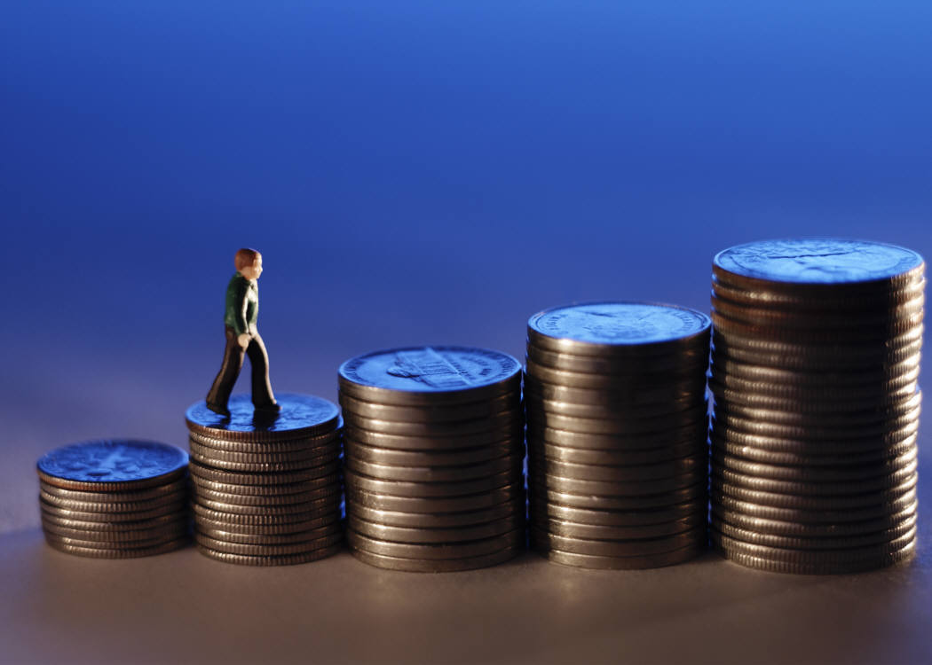
Actions mean Money

Slide 21
Performance of IPI
Department |  | 2007 | 2008 | 2009 | 2010 | Target 2013
Sales | * Collections * Sales | 45% 35% | 65% 50% | 75% 80% | 80% 50% | 90% 90%
Procurement | * Free Stocks * Purchases | 40% 60% | 60% 75% | 70% 80% | 70% 80% | 80% 85%
Financial | * Banks * Control Cash Flow * Diff Expenses | 30% 30% 50% | 65% 70% 50% | 75% 85% 70% | 85% 85% 70% | 90% 90% 85%
Production | *Quality *Production rate *Limit OT | 60% 65% 40% | 70% 70% 65% | 75% 75% 75% | 75% 70% 85% | 90% 90% 90%
Quality | * Control | 50% | 75% | 65% | 80% | 90%
MGMT | *Control * Banks | 70% 50% | 80% 80% | 75% 85% | 85% 80% | 90% 90%

Slide 22
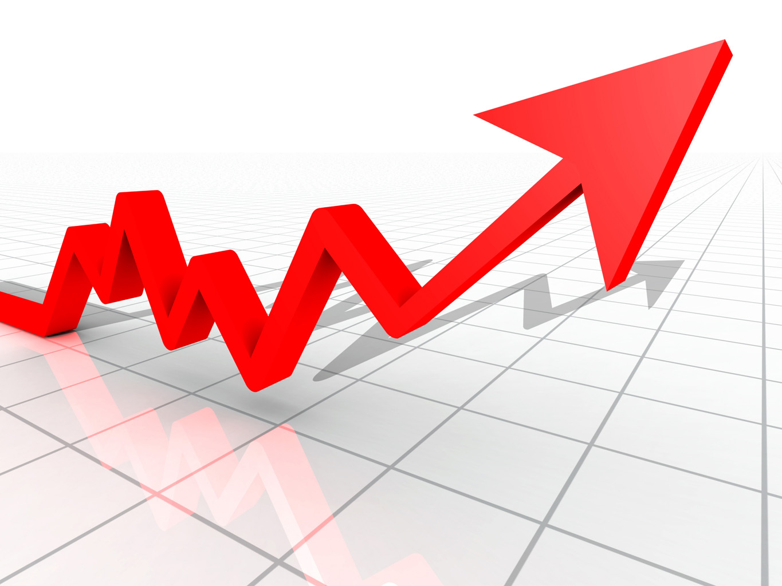

?? What happened and What is happening ??
Past 3 Years
Major Improvements in Sales and IPI Market Share
Sales didn’t yet meet their full expectations due to the turbulence of global economies
Major improvements in Production Capacities By installing new lines and re-maintaining most existing lines By applying a preventive maintenance Program and improve all infrastructure of the company.
Management improved situation with Bank by having 3 times the original facilities due to the excellent performance of IPI
New investor joined IPI and raised the capital
New penetration in exporting
Controlled Production Plan, Procurement, and Sales Plans
Rebuilt new Production/Quality staff
Next 3 Years
Start up the factories, that have been stopped due to lack of Financial Power. They have to work because: they have high demand, they are Unique, and they have a high Margin of Profits. Example: DOP factory that can produce 8000 MT yearly and can be sold out completely to Egypt with an approximate profits of 1 Million/Yr.
Improve Exporting to Egypt, Palestine, SA, and Syria. This can be done easily.
Try to add new Factories, Lines, or Products, which can have a high demand due to the change of Market need
Continue forming strong partnership with major clients, suppliers, and Banks.

Slide 23
Conclusions
NEEDED
TO
EXCELL
Production
Train production staff
Increase Salaries
Hire Production &QC
Managers & Qualified Staff
Start up DOP Factory
Implement full Automation
.Add new MB & filler Machine
Add new R&D Machines
Add Quality testing
Machines
Add spare parts machines
850,000 JD INVESTMENT
Procurement
Hire new Procurement
MGR
Have flexibility in Cash
to Stock RMs when
possible and enough
for 2-3 months
3-4 Millions JD
Sales
Hire Marketing MGR
Hire qualified Sales
representatives
Have flexibility in
cash to give incentives
to clients
Participate in fares
& regional products
advertisements
150,000 JD Ads
Financial
Hire strong accountant &
Controller
Replace bank loan with
Investors to avoid 250k
interest and delays
. Try to find ways to have
accounts credits with
suppliers and better facilities
3-4 Millions JD
HR
Hire HR Mgr
Participate in trainings
to find good qualified
employees
. Hire foreign labors
. Improve Safety
50,000 JD

Slide 24
“” IPI was able to reach the 1 million Profit in 2009 “”
IF
NO ECONOMY RECESSION
Performance of 1st 6 months
will be same like last 6 months,
,which means double the profits
Potential Additional Profit :
500,000 JD
Bank Facilities increased
Then IPI was able to choose
the time to buy RAW Materials
and gain at least 10% reduction
of RM cost
Potential Additional Profit :
500,000 JD
No Bank facilities
Then IPI was able to save
11% Yearly Interest
Potential Additional Profit :
500,000 JD
Production Capacity was Larger
Then IPI was able to increase it’s
sales by another 20%
Potential Additional Profit :
500,000 JD

Slide 25
Turn Over is 3 times a year
 | 1 | 30 |  | 60 |  | 90 |  | 120
 | Jan |  | February |  | March |  | April
 | RM Ordering |  | RM Arrival |  | Production |  |  | Payments
 | Day # 1 |  | Day # 45 |  | Day # 75 |  |  | Day # 120
Bank limit is 2 millions: (X) 3 Times = 6Millions Sales
Bank limit is 3 millions: (X) 3 Times = 9Millions Sales
Bank limit is 4 millions: (X) 3 Times = 12Millions Sales
Bank limit is 5 millions: (X) 3 Times = 15 Millions Sales

Slide 26

A successful trip needs the first mile, have a nice journey

